Slide 1
Carbon Monitoring and Projection: Permanent Forest Loss
Quan Shen

Slide 2

Project Overview
Purpose
Project permanent forest loss
Background
Monitor carbon stock and calculate carbon budget for U.S. Climate Alliance
The Ecosystem Dynamics (ED) model assumes no new permanent loss
Improve the accuracy of the ED model results by incorporating permanent forest loss

Slide 3
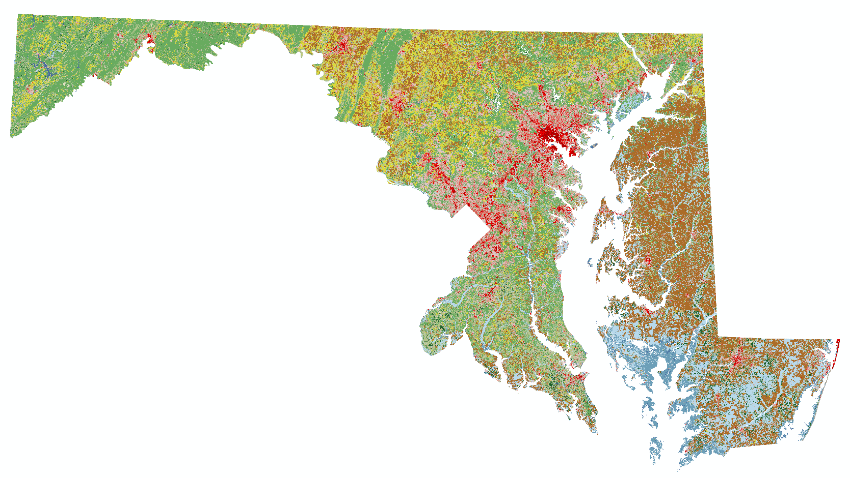
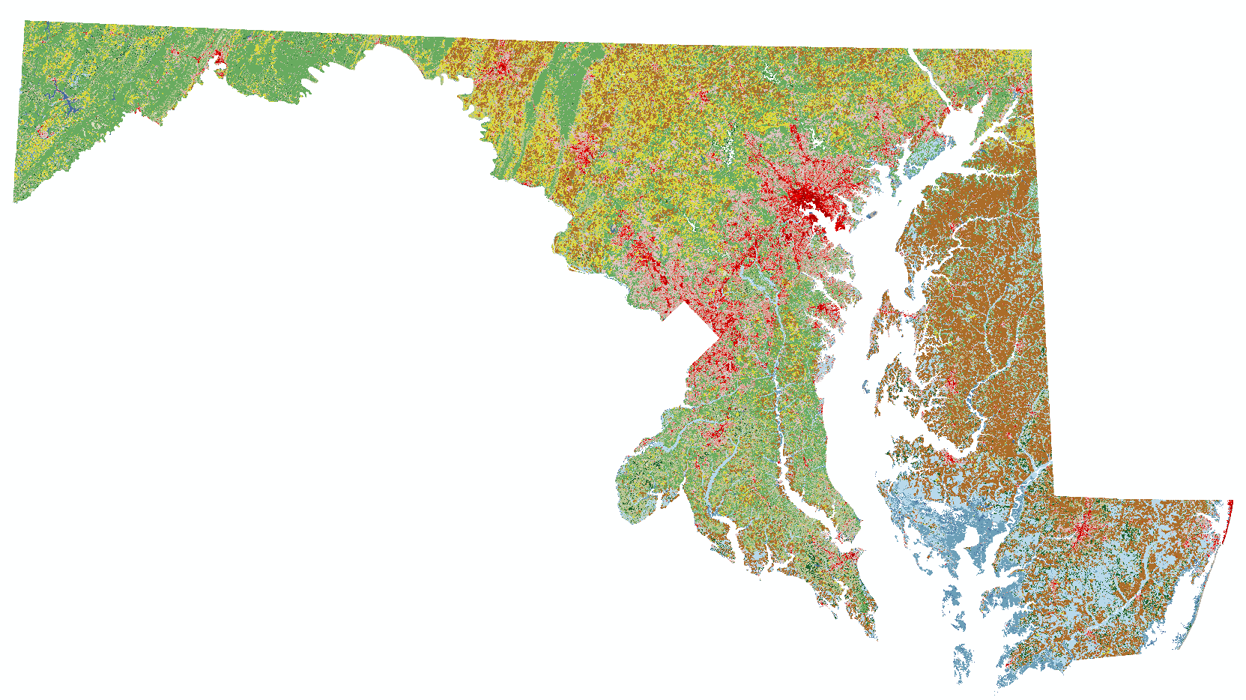
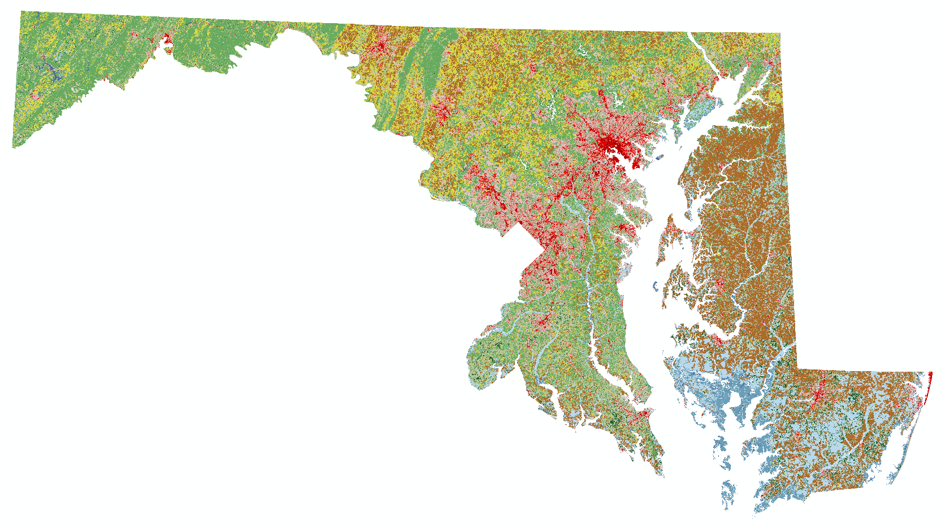
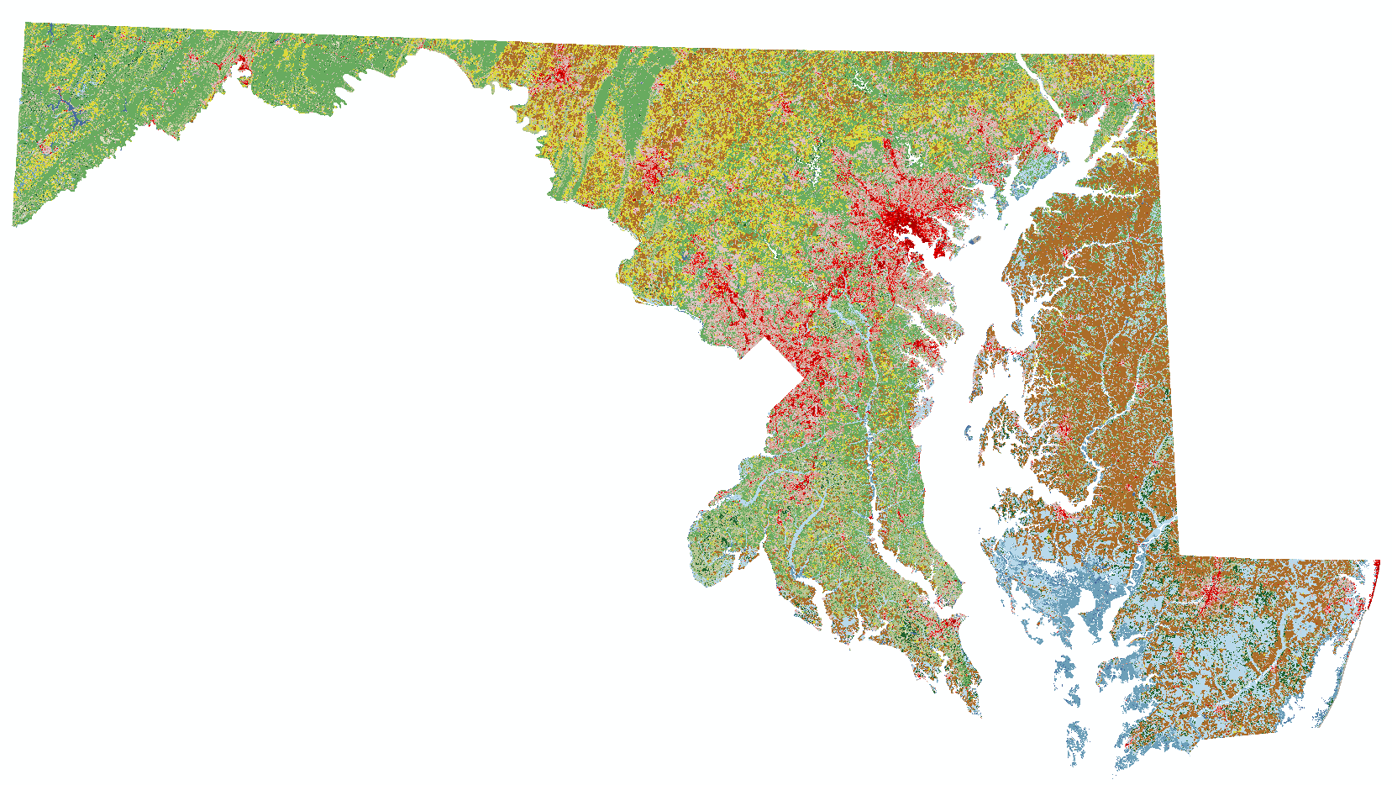
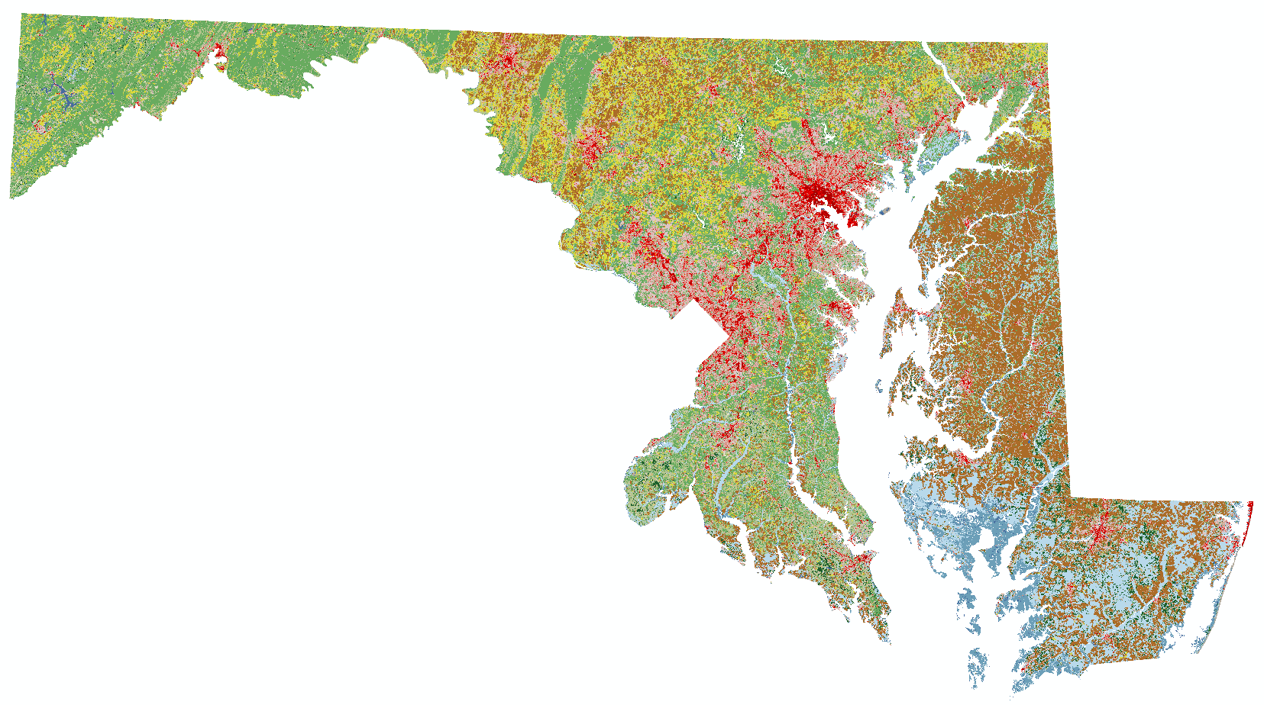

Data Update
Run
Validate
NLCD Land Cover Data
Original time period: 2001, 2006, 2011, 2016
New time period: 2004, 2006, 2008, 2011, 2013, 2016
Run
Validate

Slide 4
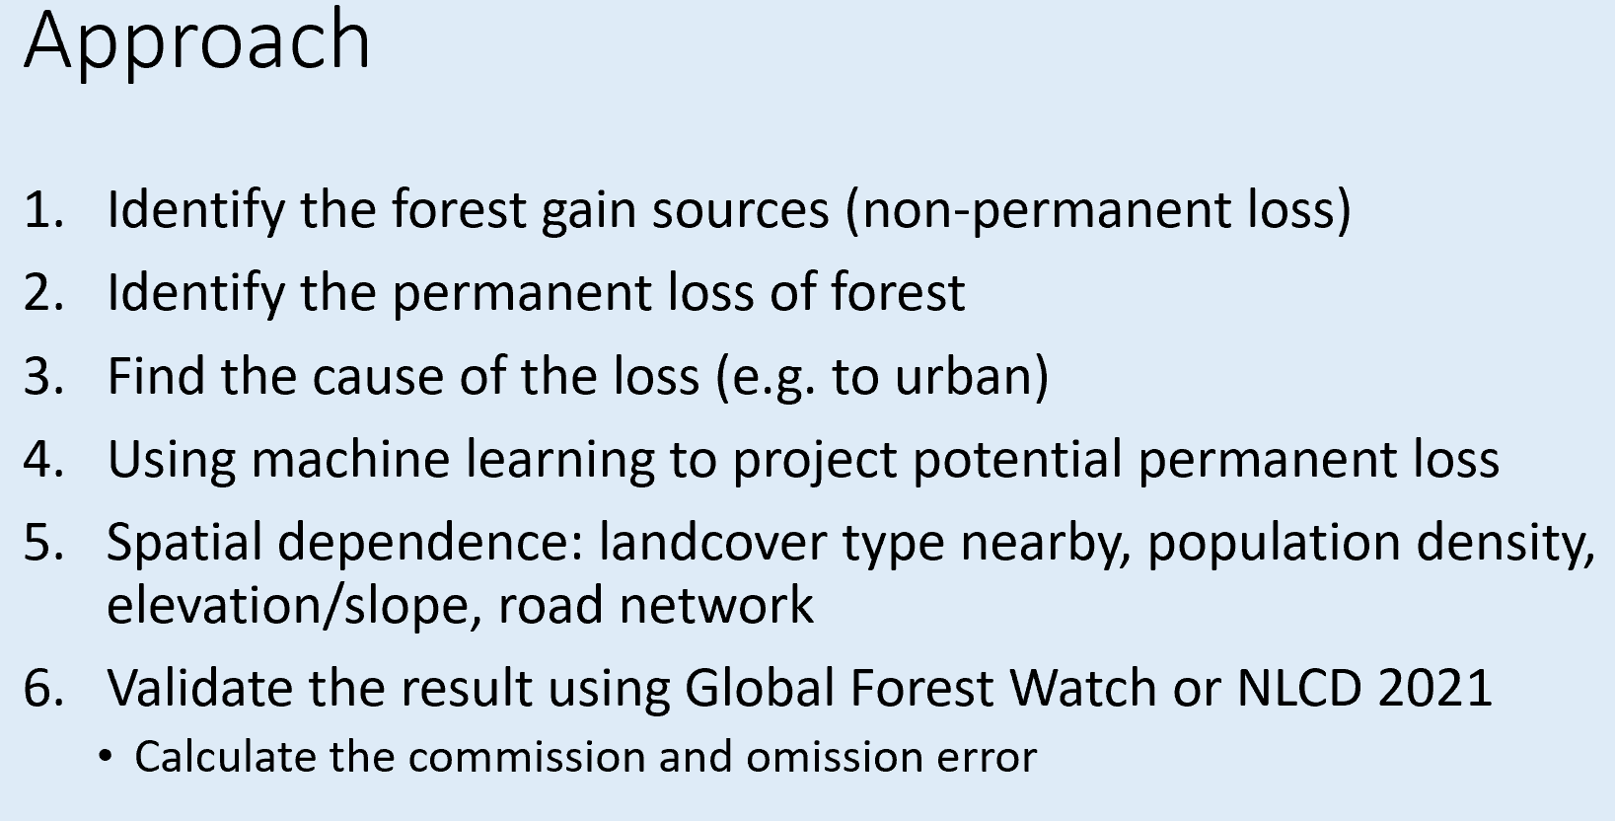
Progress Report

Slide 5
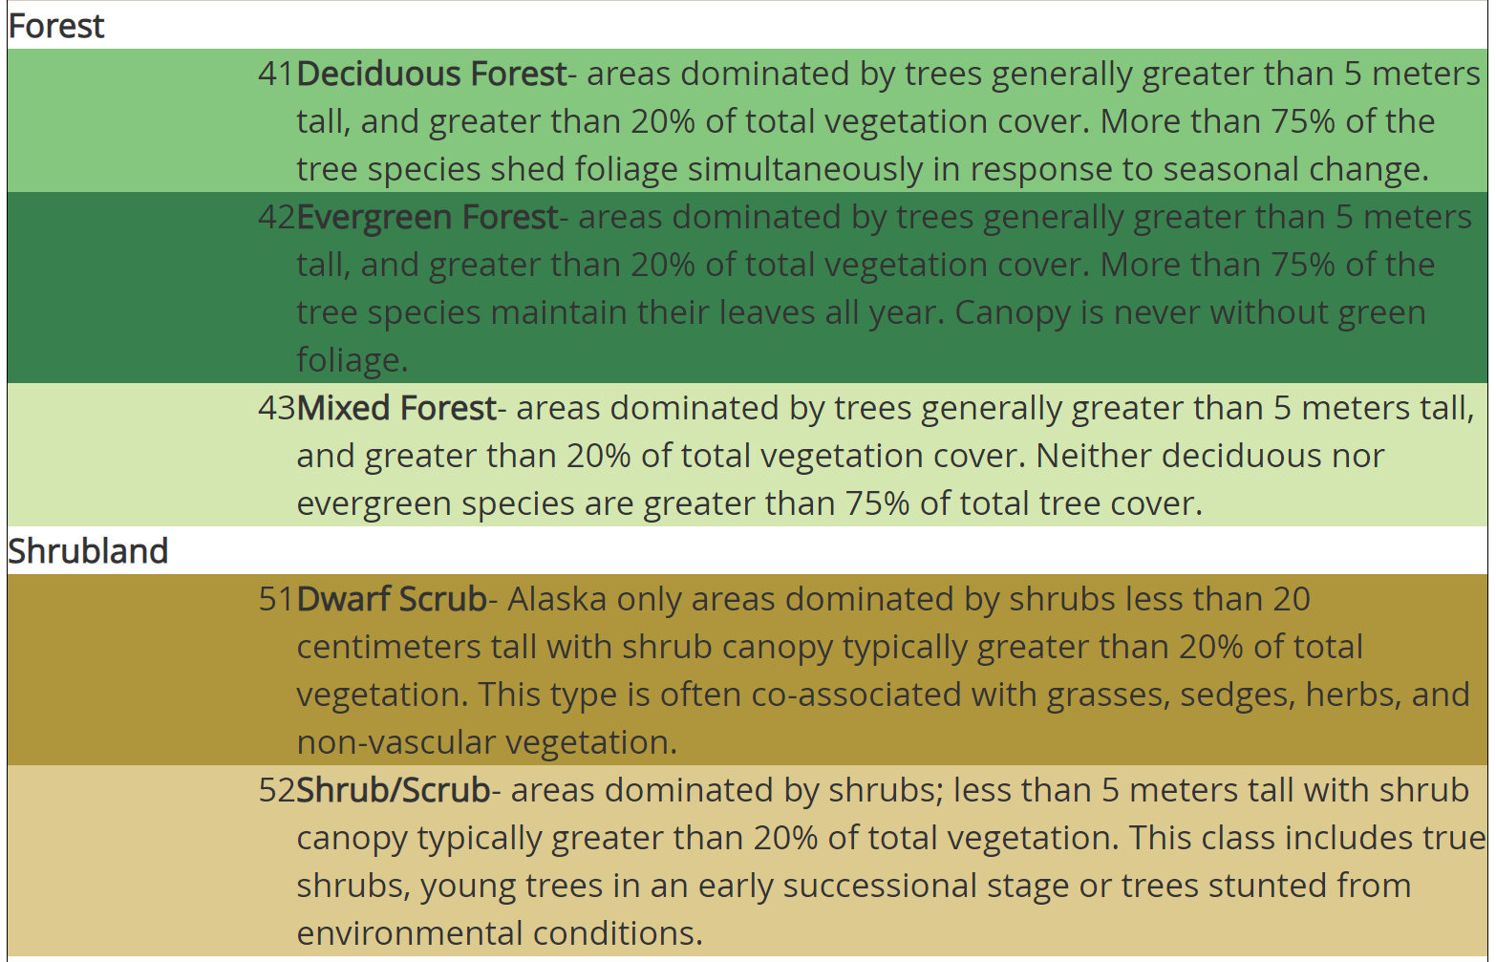
NLCD Land Cover Data Legend
Water → 10
Developed → 20
Barren → 30
Forest → 40
Shrubland → 50
Herbaceous → 70
Cultivated → 80
Wetland → 90
https://www.mrlc.gov/data/legends/national-land-cover-database-2016-nlcd2016-legend

Slide 6
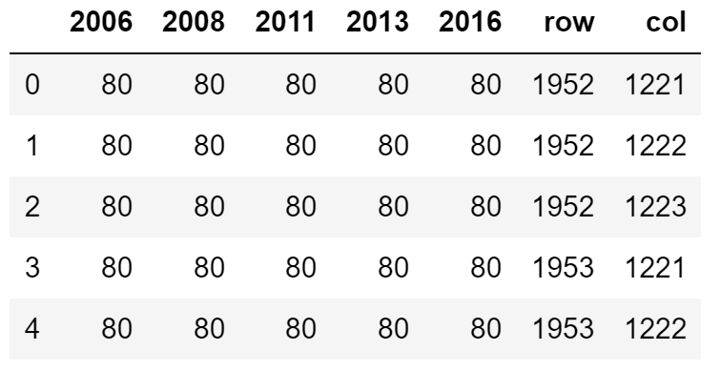
Methodology
Identify pixels of forest loss in 2004 – 2016
Forest in 2004, non-forest after

Slide 7
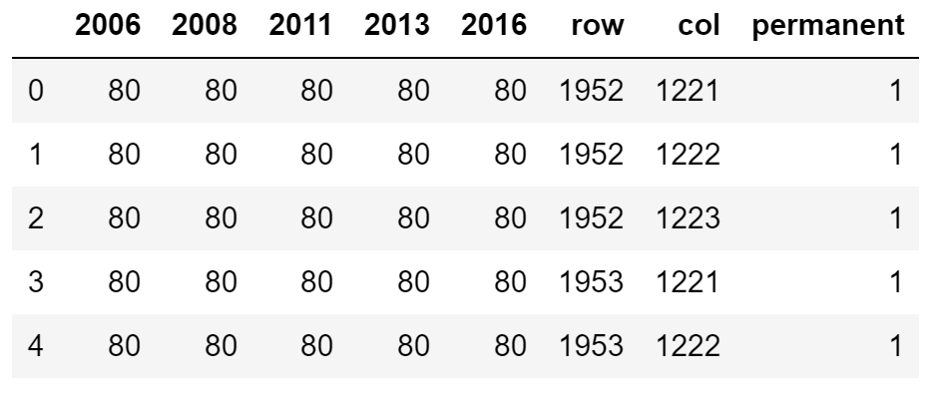
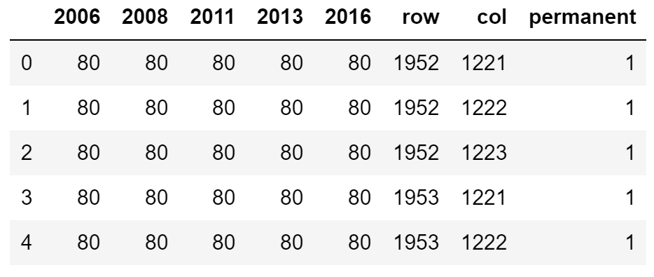
Methodology
Identify permanent and non-permanent loss in 2004 - 2013
Permanent: non-forest after 2004
Non-permanent: non-forest becomes forest after 2004
Cultivated → 80

Slide 8
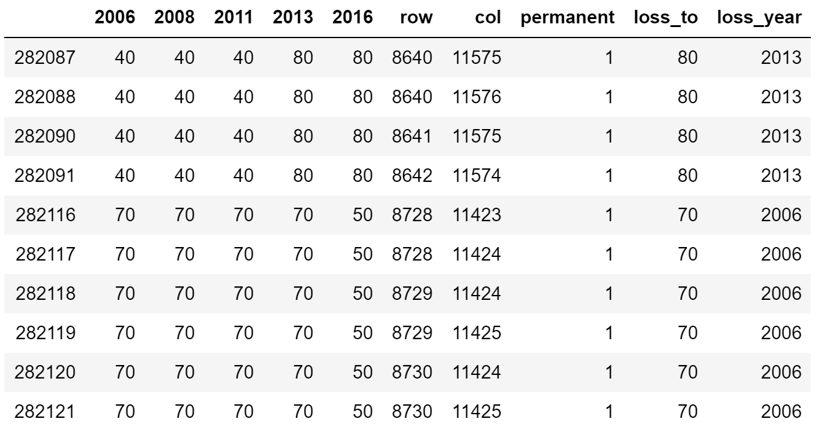
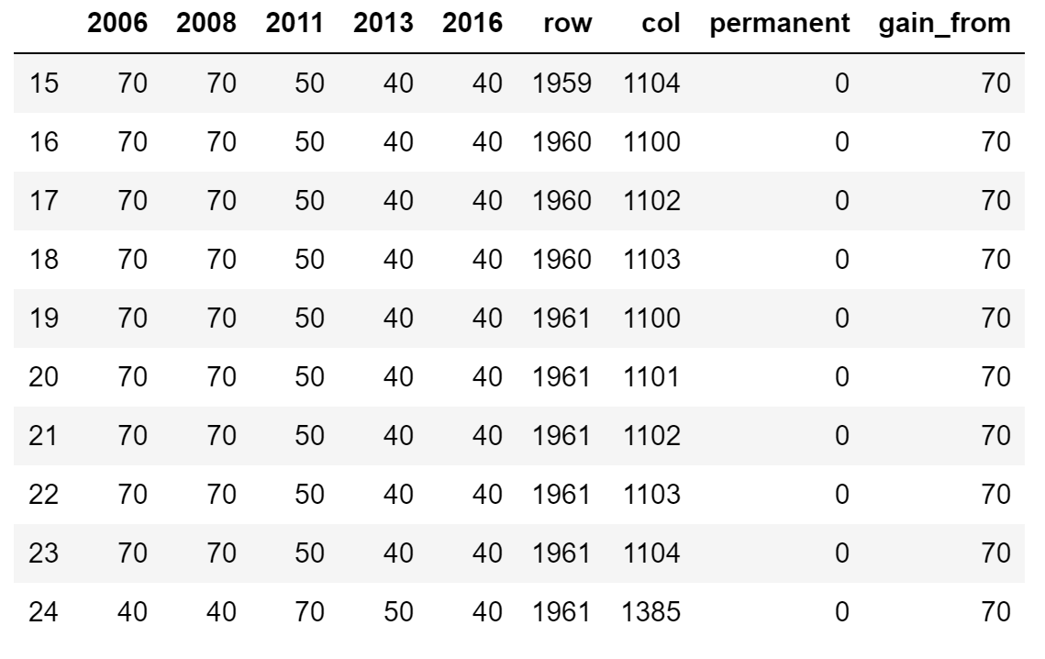
Methodology
Permanent loss
Find loss-to landcover type
Find the year of loss
Cultivated → 80
Non-permanent
Find gain-from landcover type
Forest → 40
Herbaceous → 70
Shrubland → 50

Slide 9
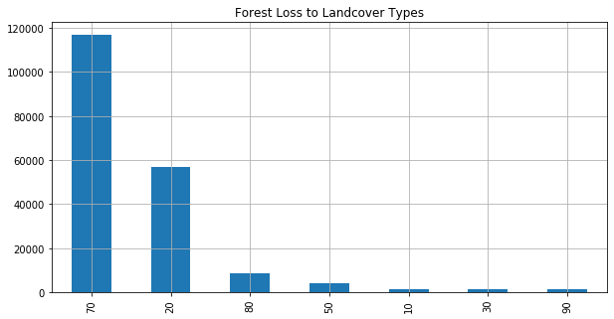
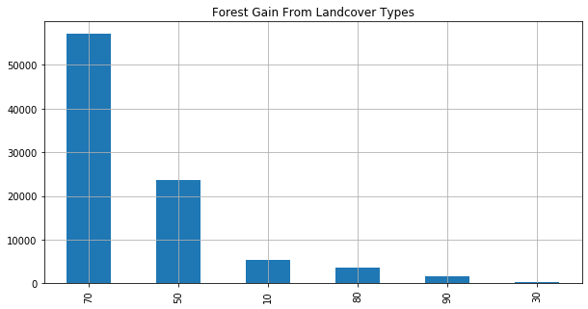
Result
Forest loss to developed is permanent
Permanent loss
Find loss-to landcover type
Non-permanent
Find gain-from landcover type

Slide 10
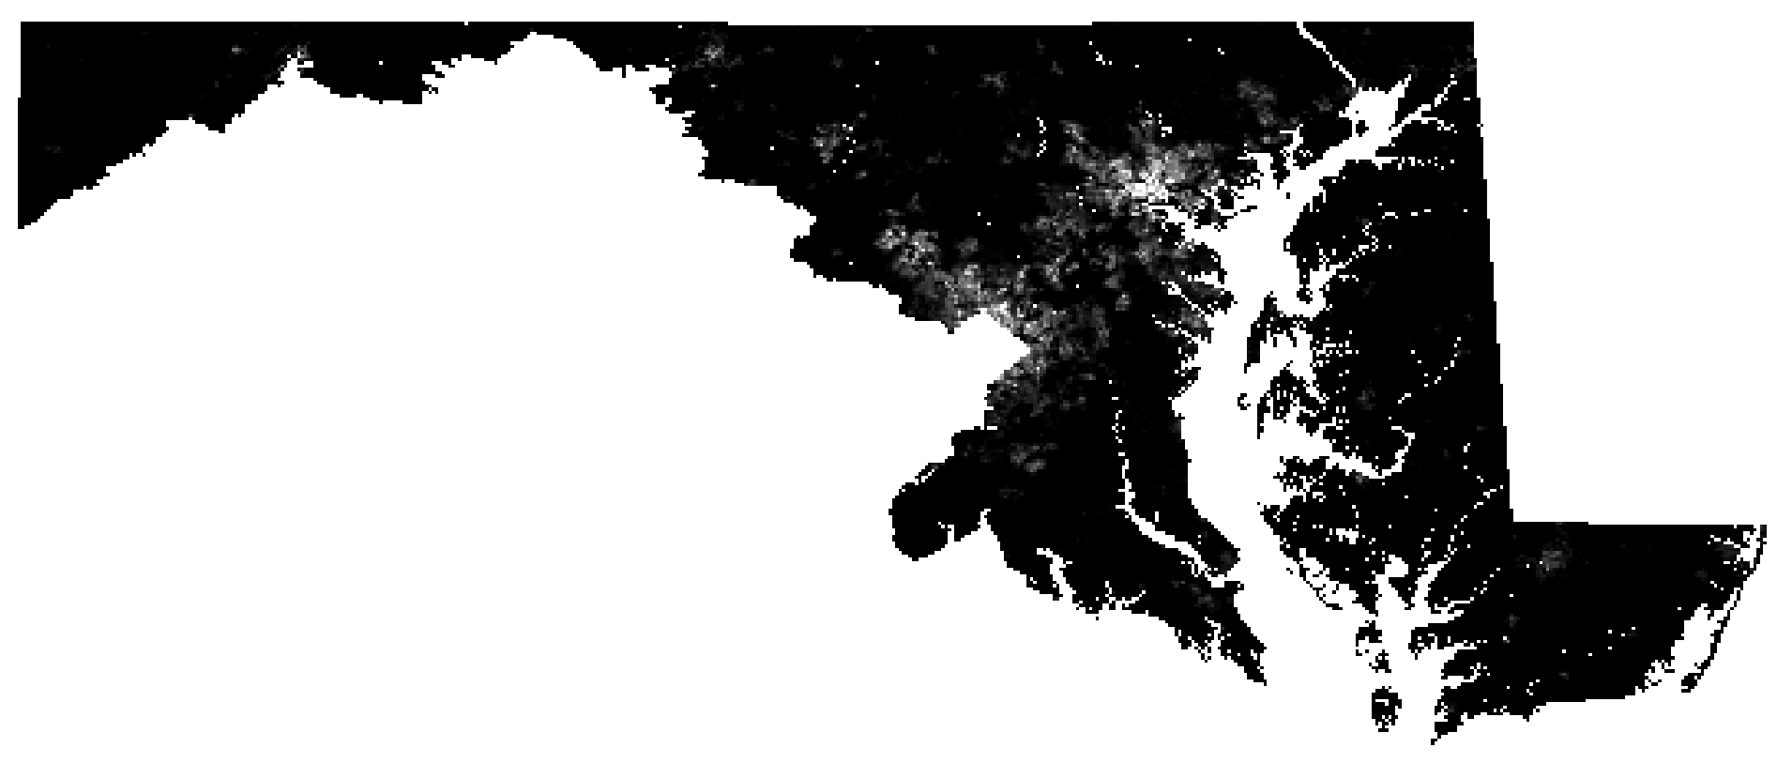
Population Density
Data source: NASA's Earth Observing System Data and Information System
Data type: raster data
Time period: 2005, 2010, 2015
Resolution: 1 km
Study area: Maryland
Preprocess: clip, reproject, resample to 30m
Concerns:
Coarse resolution
Unmatched years

Slide 11
Challenge
Decide the loss-to and gain-from landcover type

Slide 12
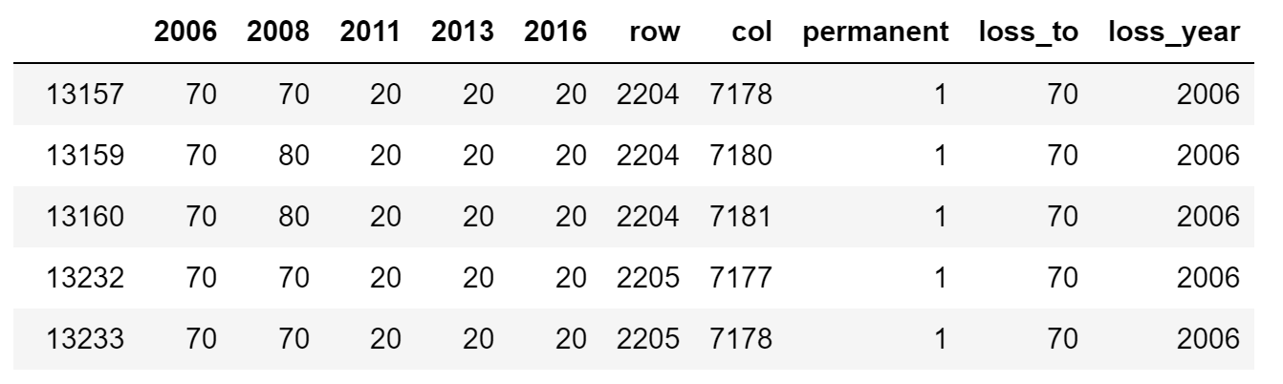
Challenge
Decide the permanent loss
Only direct transition from forest to developed counts

Slide 13
Timeline of next steps
11/2: finish the preprocessing of the population density data
11/9: use GWR to assess the influence of population density
11/16: try random forest
11/23: modify random forest
11/30: validate the results

